Slide 1
DBT and Snowflake
Kerry Nakayama

Slide 2


dbt handles boilerplate code to materialize queries as relations
A materialization represents a build strategy for your select query
dbt ships with the following built-in materializations:
view (default): The model is built as a view in the database.
table: The model is built as a table in the database.
ephemeral: The model is not directly built in the database but is instead pulled into dependent models as common table expressions.
incremental: The model is initially built as a table, and in subsequent runs, dbt inserts new rows and updates changed rows in the table
Notes:
As a dbt user, your main focus will be on writing models (i.e. select queries) that reflect core business logic – there’s no need to write boilerplate code to create tables and views, or to define the order of execution of your models. Instead, dbt handles turning these models into objects in your warehouse for you
wraps your select query in a statement to create a new, or update an existing, relation
Since your company wants you all to write in CTEs we should focus on ephemeral
In other words based on the queries that you write it will realize certain components need to be completed first before the model can be built
for example say you are cleaning a transactions table you might have the orders all in one table and the payments in another and will need to join the two tables together.

Slide 3
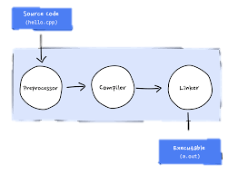
What else can dbt do
Jinja – code compiler - Light weight templating language
It takes loops and if statements and enables repeated SQL
Documentation – tracking on the deployed code
write, version-control, share documentation
QA and testing – set validation/integrity checks for your code
Seed file loader – mapping more readable values
Load data that doesn’t change to map to incoming data for comparisons
Notes:
Controls structures
Revenue forecasts/ goals compared to incoming numbers
Country codes that need to be mapped
Understanding raw data
Snapshot to compare old data

Slide 4

Making code “DRY” (don’t repeat yourself)
Using loops for repeated code that iterates through a list
Use macros to return lists
{%Macro get_payment_methods () %}
Use macros that have already been solved in dbt-utils
{% set payment_methods = ["bank_transfer", "credit_card", "gift_card"] %}
SELECT order_id,
{% FOR payment_method IN payment_methods %}
SUM(CASE WHEN payment_method = '{{payment_method}}’ THEN amount END) AS {{payment_method}}_amount,
{% endfor %}
SUM(amount) as total_amount
FROM {{ ref('raw_payments') }}
GROUP BY 1
Notes:
select
order_id,
sum(case when payment_method = 'bank_transfer' then amount end) as bank_transfer_amount,
sum(case when payment_method = 'credit_card' then amount end) as credit_card_amount,
sum(case when payment_method = 'gift_card' then amount end) as gift_card_amount,
sum(amount) as total_amount
from {{ ref('raw_payments') }}
group by 1
select
order_id,
{% for payment_method in ["bank_transfer", "credit_card", "gift_card"] %}
sum(case when payment_method = '{{payment_method}}' then amount end) as {{payment_method}}_amount,
{% endfor %}
sum(amount) as total_amount
from {{ ref('raw_payments') }}
group by 1
This list is short but imagine having a huge list of payment types or maybe user agents
Create a macro from another model that may contain the entire list and use it instead of hardcoding the list. Helps with updates to the list without having to go in and change the code.
Imagine having to remember all the locations this code might be used and you have to change all of them.
Whenever you're trying to solve a problem that you think others may have solved previously, it's worth checking the dbt-utils package to see if someone has shared their code!

Slide 5

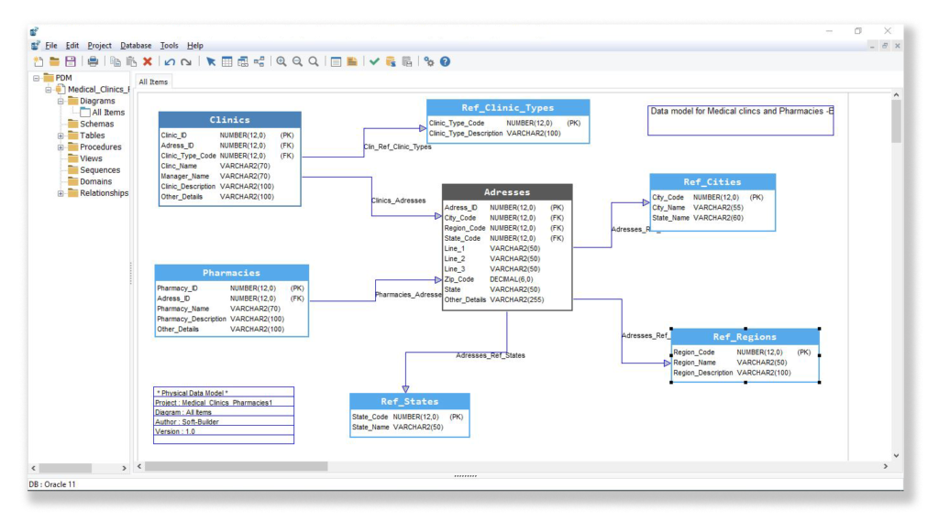

dbt Projects
Project formats have two main types
.yml
Essentially you config files
Help with ordering to create models
.sql
Model files are written in SQL
Don’t forget to COMMIT changes
dbt acts like a repository for your work
Version control
Keeps up-to-date code
Notes:
Remember in mod 1 we discussed config files
The files can contain a multitude of other resources like snapshots, seeds, tests, macros, documentation, or sources

Slide 6

Repositories
Create repositories that directly connect to dbt
Adding a repository is as simple as inputting the URL
Github vs Gitlab
Notes:
Authentication Levels
With GitLab you can set and modify people’s permissions according to their role. In GitHub, you can decide if someone gets a read or write access to a repository
With GitLab you can provide access to the issue tracker (for example) without giving permission to the source code. This is obviously great for larger teams and enterprises with role-based contributors.
One of the big differences between GitLab and GitHub is the built-in Continuous Integration/Delivery of GitLab
GitLab offers its very own CI for free. No need to use an external CI service. And if you are already used to an external CI, you can obviously integrate with Jenkins, Codeship, and others
GitHub offers various 3rd party integrations – such as Travis CI, CircleCI or Codeship – for running and testing your code. However, there’s no built-in CI solution at the moment
operations dashboard that lets you understand the dependencies of your development and DevOps efforts
Both are great issue trackers, especially when connected with a visual bug tracker like Usersnap
GitLab offers detailed documentation on how to import your data
If you’re looking for the biggest community of developers, chances are high that GitHub is the better place to be

Slide 7
GIT Pull vs Push Request
A "pull request" is you requesting the target repository to please grab your changes
A "push request" would be the target repository requesting you to push your changes
Notes:
If you have a code change in your repository, and want to move it to a target repository, then:
"Push" is you forcing the changes being present in the target repository (git push).
"Pull" is the target repository grabbing your changes to be present there (git pull from the other repo).

Slide 8

Best Practices
Best Practices

Slide 9

Confused? ASK QUESTIONS

Slide 10
Break & Lab 9
Notes:
DBT working session

